Slide 1

Beyond QWERTY: Revolutionizing Medical Insurance Form Filling with AI-Powered Voice Recognition
An AI-Intensive Project Transforming Traditional Data Entry
Presented by Rishiraj Yadav, Intern at Infosys AI Springboard, Batch 2

Slide 2
Project Overview: Voice-Based Form Filling
Objective
Problem
Replace keyboard entry with AI-powered voice-to-text.
Manual forms are tedious, error-prone, and inaccessible.
Modernizing Insurance
Transforming Data Entry
Our project aims to revolutionize medical insurance form filling using cutting-edge AI technology, specifically voice recognition.
We envision a future where forms can be filled accurately and quickly, simplifying the process for both users and insurance providers.

Slide 3
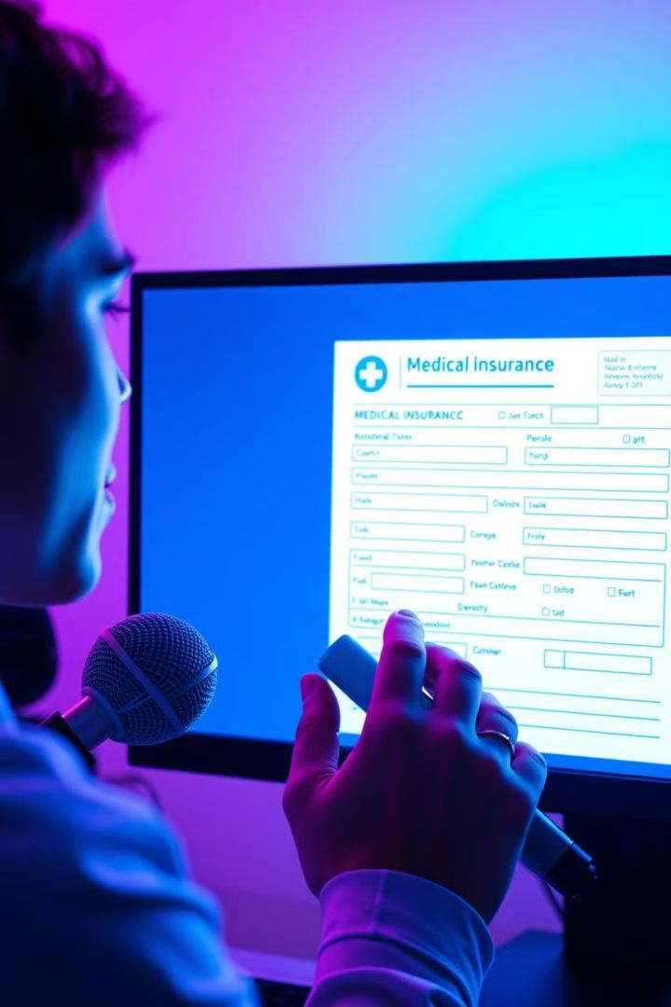




Introducing Voice Recognition Technology
Speech-to-Text
Our solution utilizes AI-powered voice recognition technology, allowing users to dictate their information.
PDF Generation
Dynamically creates forms with details.
Automated Data Entry
The system translates spoken words into text, automatically populating form fields.
Accuracy and Efficiency
This streamlines the process, reduces errors, and significantly improves efficiency.

Slide 4




AI-Powered Voice-Based Form Filling: Key Features
Speech Recognition
1
Our system uses the WebkitSpeechRecognition API to process and understand spoken language.
Natural Language Processing
2
It utilizes NLP to interpret the meaning of user's speech, extracting relevant data.
Form Validation
3
The system ensures that the captured data is accurate and adheres to the form's structure.
PDF Generation
4
The filled form is automatically generated as a PDF, ready for submission.

Slide 5
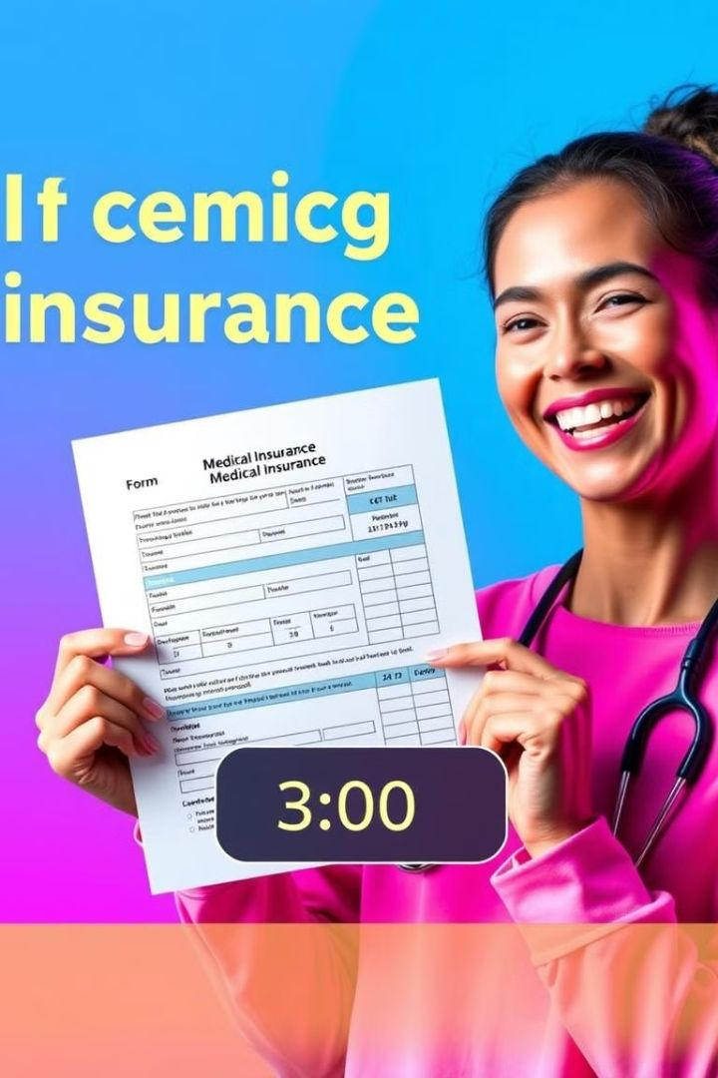
Impact on Productivity and Efficiency
30%
Time Savings
Significantly reduces the time required to complete forms, boosting productivity.
80%
Error Reduction
Minimizes data entry errors, leading to fewer corrections and rework.
95%
User Satisfaction
Enhances user experience by simplifying the process and reducing frustration.

Slide 6




The Future of AI-Driven Medical Insurance
Personalized Forms
AI can personalize forms based on individual user profiles and medical history.
Real-Time Assistance
Users can receive real-time feedback and guidance during form completion.
Advanced Analytics
Insurance companies can leverage data insights from forms to improve decision-making.

Slide 7

Technical Architecture
Frontend
Backend
HTML, CSS, and JavaScript for a user-friendly interface.
Flask Framework for routing, handling requests, and processing data.
Database
PDF Generation
MySQL for secure storage of user and form data.
ReportLab library for dynamic PDF creation.

Slide 8



WebkitSpeechRecognition API
Browser-Based
1
Real-time speech-to-text conversion.
Machine Learning
2
Uses NLP techniques to transcribe speech to text.
Benefits
3
High accuracy, easy adaptation, reduces typing errors.

Slide 9

WebkitSpeechRecognition API
const recognition = new WebkitSpeechRecognition();
recognition.lang = 'en-US';
recognition.start();
recognition.onresult = (event) => {
const transcript = event.results[0][0].transcript;
// Process the transcript and populate the form fields.
};

Slide 10
Workflow Structure
User Authentication
1
Users log in to the platform with their credentials or create an account.
2
Form Navigation
Users select the desired form from a list or by searching for specific terms.
Voice Input
3
Users speak their information, which is captured by the voice recognition engine.
4
Translation and Validation
The system translates spoken words into text, validating the data for accuracy.
PDF Generation
5
A PDF of the filled form is generated and made available for download or submission.

Slide 11
AI Integration in Detail
Speech Recognition
1
Leveraging NLP to understand and transcribe user inputs.
Multilingual Support
2
Powered by Google Translate to ensure inclusivity.
Automation
3
Voice recognition combined with PDF generation eliminates manual effort.

Slide 12
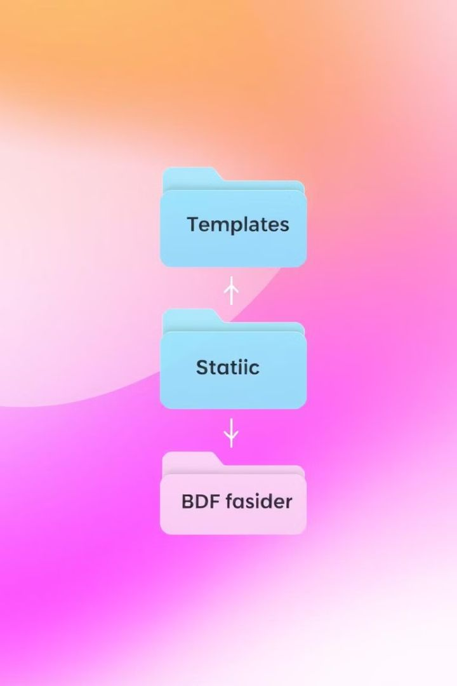
Folder Structure
1
2
Templates
Static
Contains all HTML files.
Stores CSS and JavaScript for UI/UX enhancement.
3
4
Backend
PDF Generation
app.py contains Flask routes, API integrations, and database logic.
Managed using ReportLab and BytesIO modules.

Slide 13






Challenges & Solutions
Challenge 1
Handling speech recognition accuracy in noisy environments.
Solution
Implement noise cancellation algorithms.
Challenge 2
Managing multilingual inputs.
Solution
Robust integration with Google Translate API.
Challenge 3
Dynamic PDF creation with complex forms.
Solution
Use ReportLab library for scalable PDF generation.

Slide 14
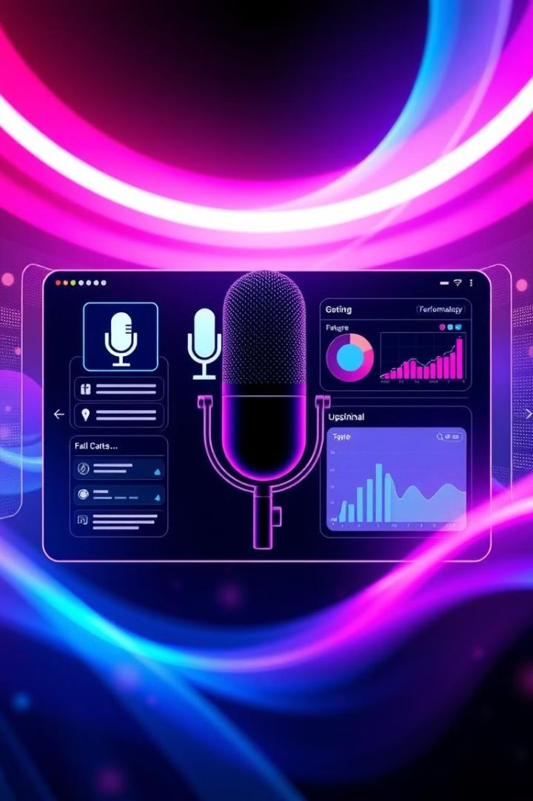
Accuracy Analysis: WebkitSpeechRecognition in Beyond QWERTY
The accuracy of WebkitSpeechRecognition within our Beyond QWERTY project.

Slide 15
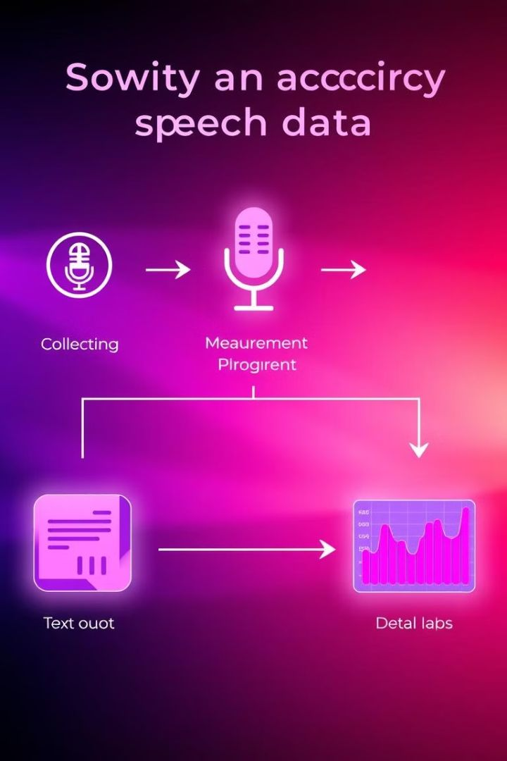
Methodology for Accuracy Measurement
1
Data Collection
We collected a diverse dataset of speech samples covering various accents and linguistic styles.
2
Recognition Testing
The dataset was fed into the WebkitSpeechRecognition API to measure the accuracy of transcriptions.
3
Analysis and Evaluation
We compared the transcribed text to the original speech to determine the percentage of accurate recognition.

Slide 16
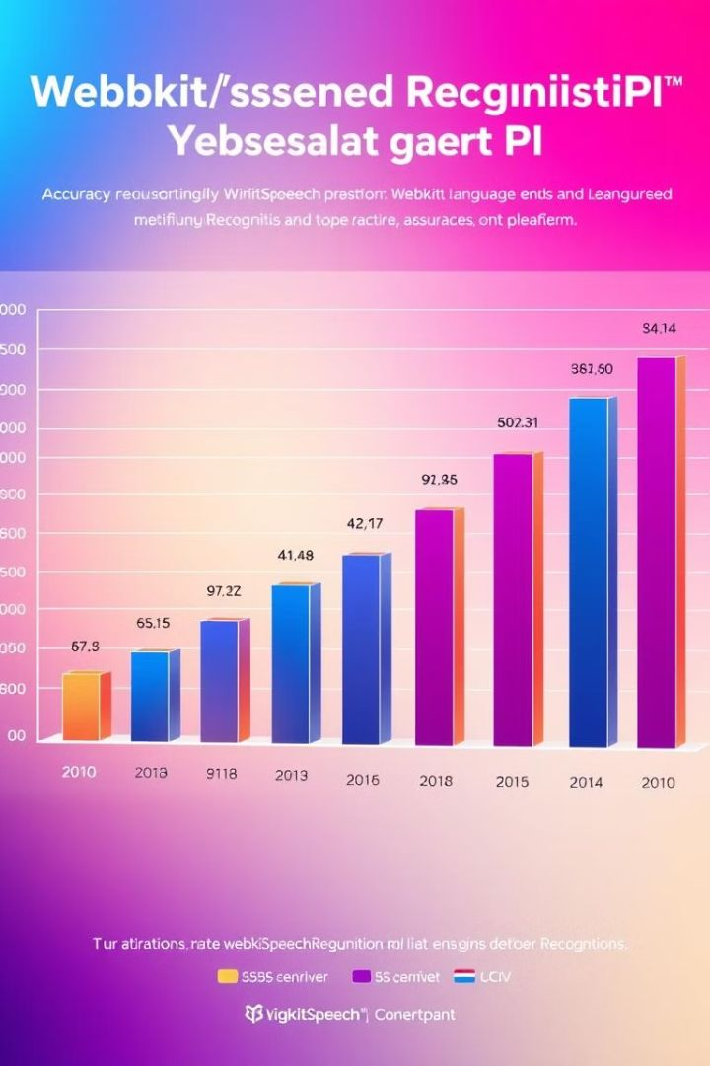
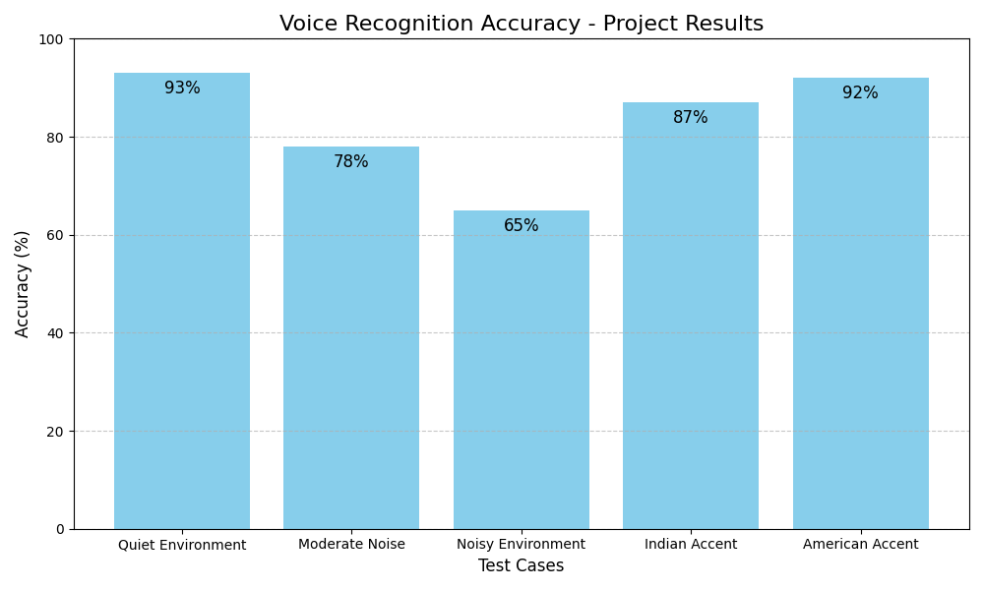
Key Findings: Recognition Accuracy Rates

Slide 17




Future Improvements and Next Steps
Adaptive Learning
Multilingual Support
Personalized Settings
Continued development of AI-powered models to improve recognition accuracy over time.
Expanding support for a wider range of languages to cater to diverse user populations.
Allowing users to adjust settings like accent and noise cancellation to optimize accuracy.

Slide 18
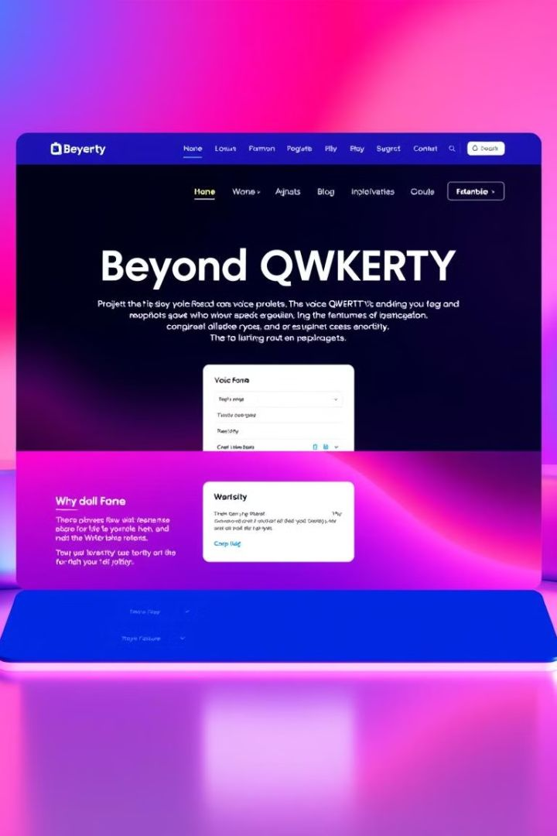
Beyond QWERTY in Action: Project Demo
Real-Time Demo: Voice Form Filling Process

Slide 19
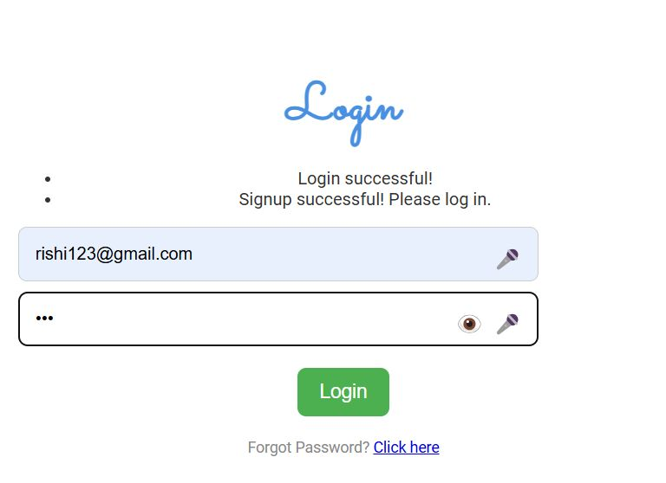
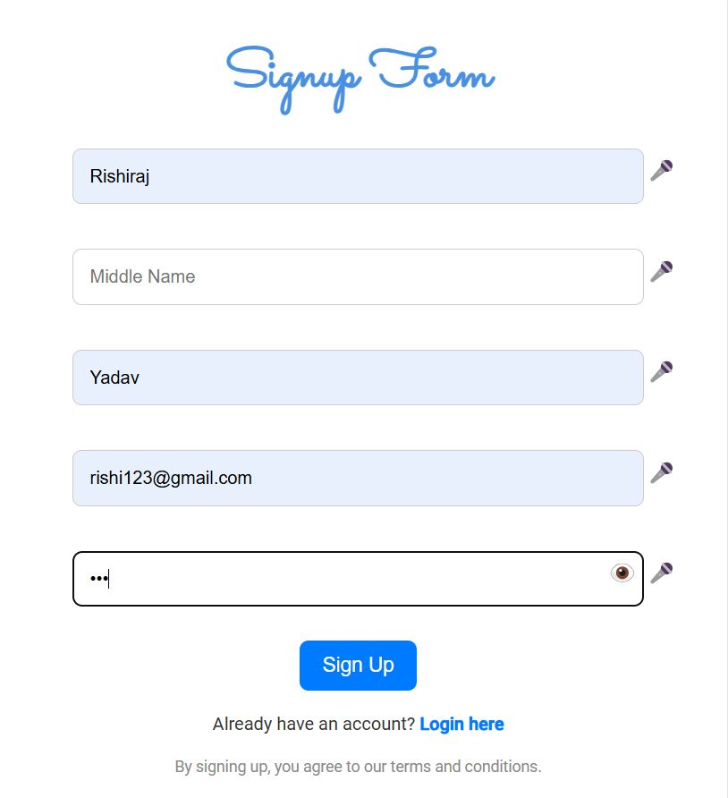
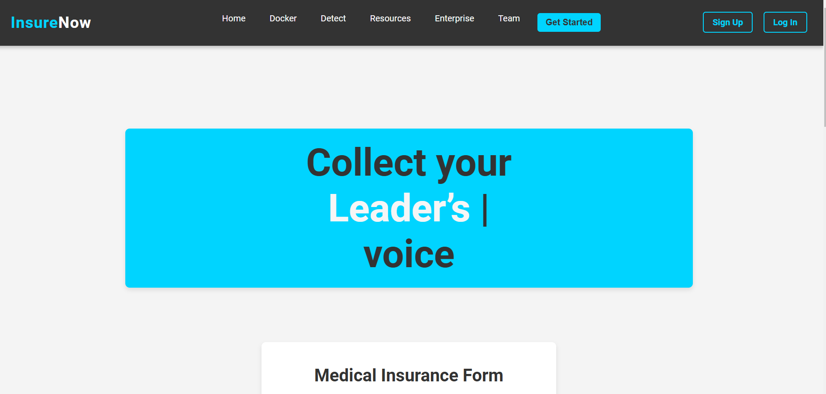
Beyond QWERTY in Action: Project Demo
Click to Open Mic
&
Enter the Input

Slide 20
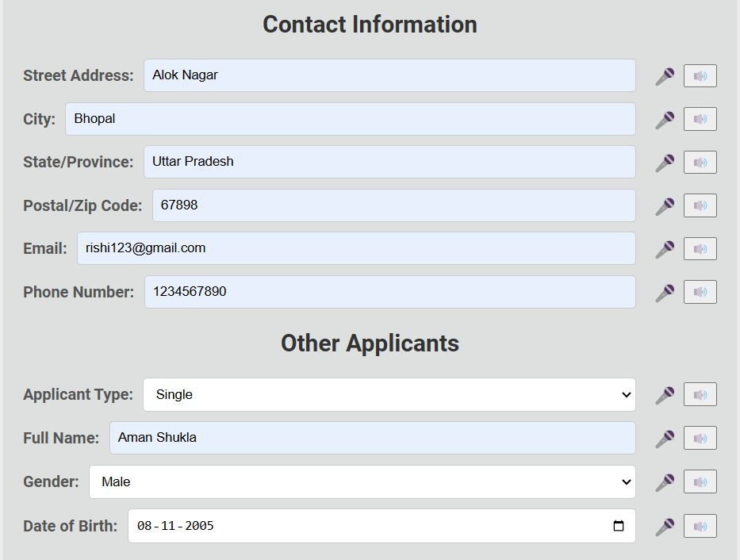
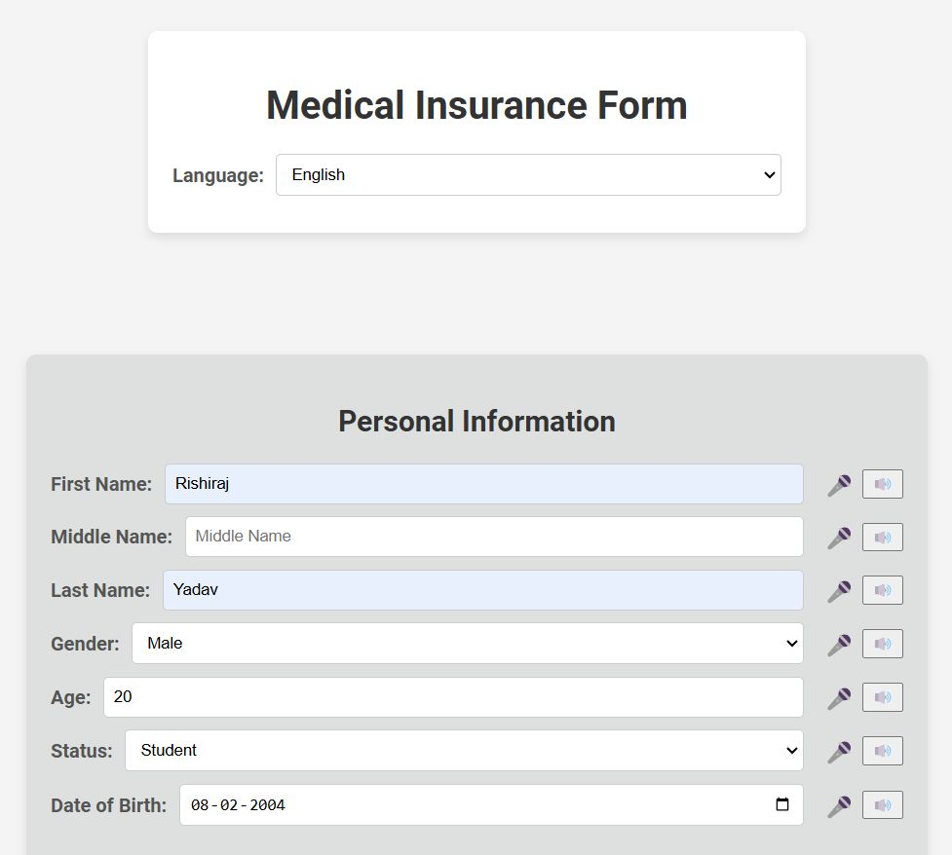
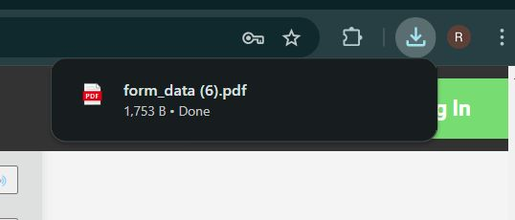

Slide 21
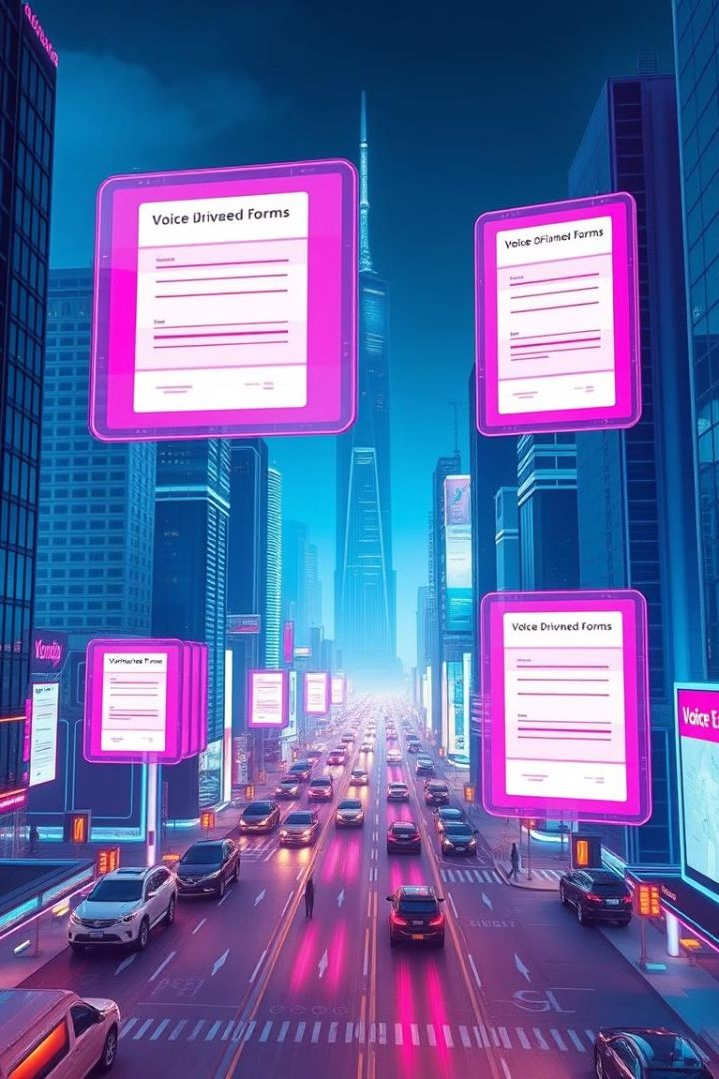
The Future of Voice-Driven Form Filling
Voice-driven form filling is poised to transform how we interact with technology. As voice recognition technology continues to advance, we can expect to see even more sophisticated and user-friendly voice-driven forms in various applications, making information gathering more accessible and efficient.

